Slide 1
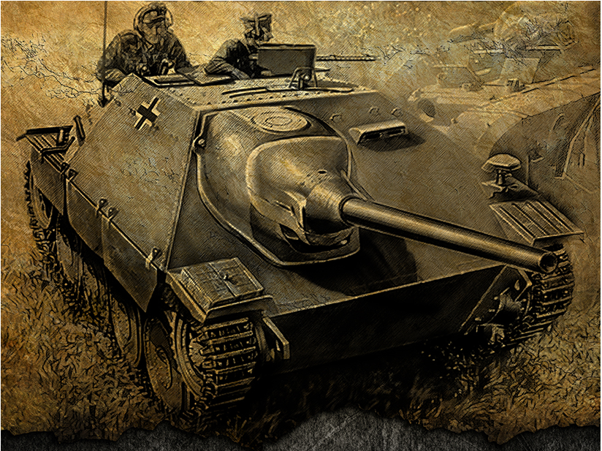
Hetzer Wars
Aayush Kothari and Raghava Ravi
Notes:
Aayush

Slide 2
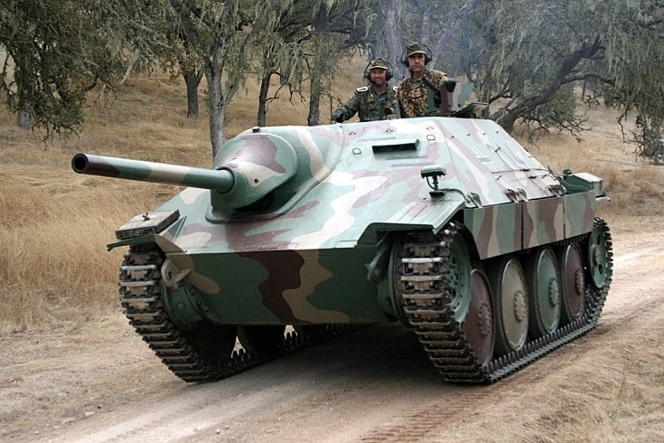
Intro
Commander, a war has been declared on the bordering nation. The fate of our nation rests upon your shoulder. Hone your skills, oil your tank, and gear up for battle.
Background
Side mounted turret comes from Hetzer Tank design
Notes:
Raghava

Slide 3
General program description
In this 2-player game, players will navigate tanks across the map in order to take their opponent’s tanks while sustaining the least damage possible to themselves. Players start at different locations of the map and must navigate around the walls. Players gain advantages through the power-ups and must avoid bombs. Tank who destroys the other person’s tanks wins.
Simply Put: Take out the enemy tank and sustain the minimum damage in order to win
Notes:
Aayush

Slide 4
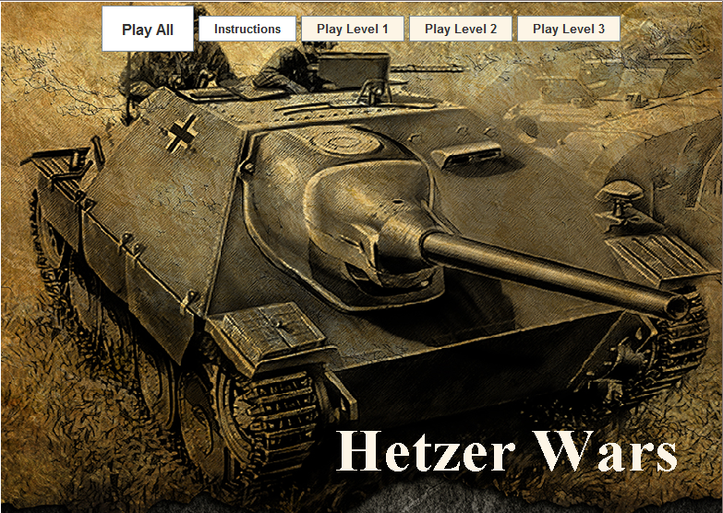
Notes:
Raghava

Slide 5
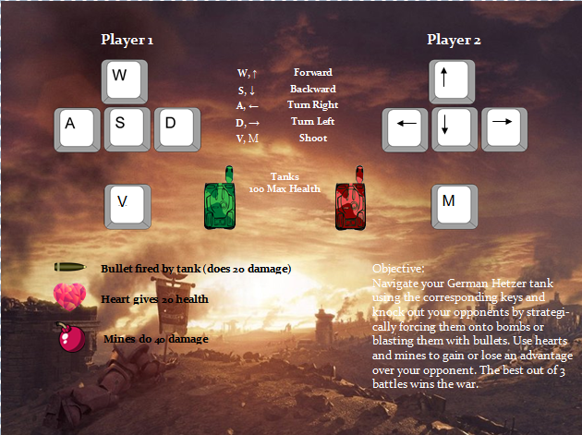
Notes:
Aayush

Slide 6
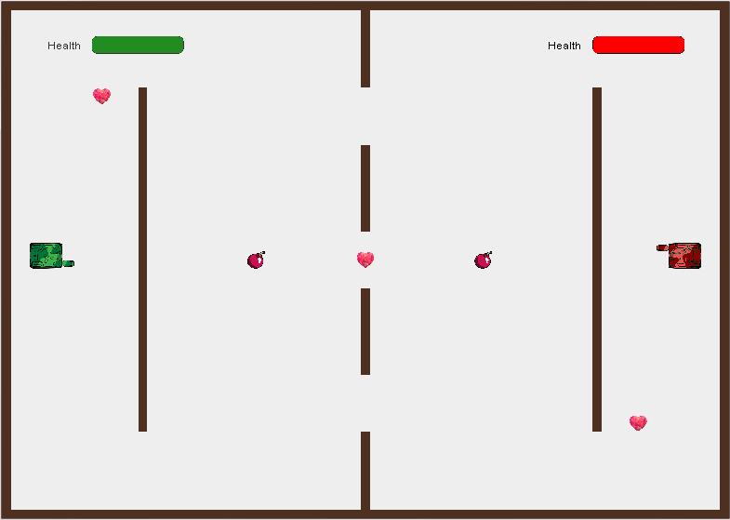
Notes:
Raghava

Slide 7
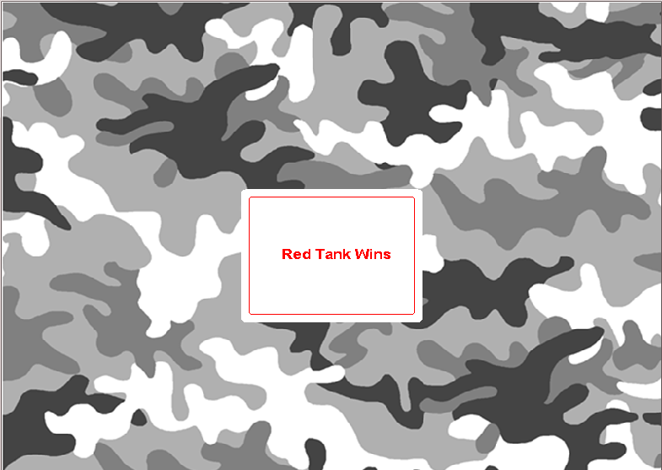
Notes:
Aayush

Slide 8
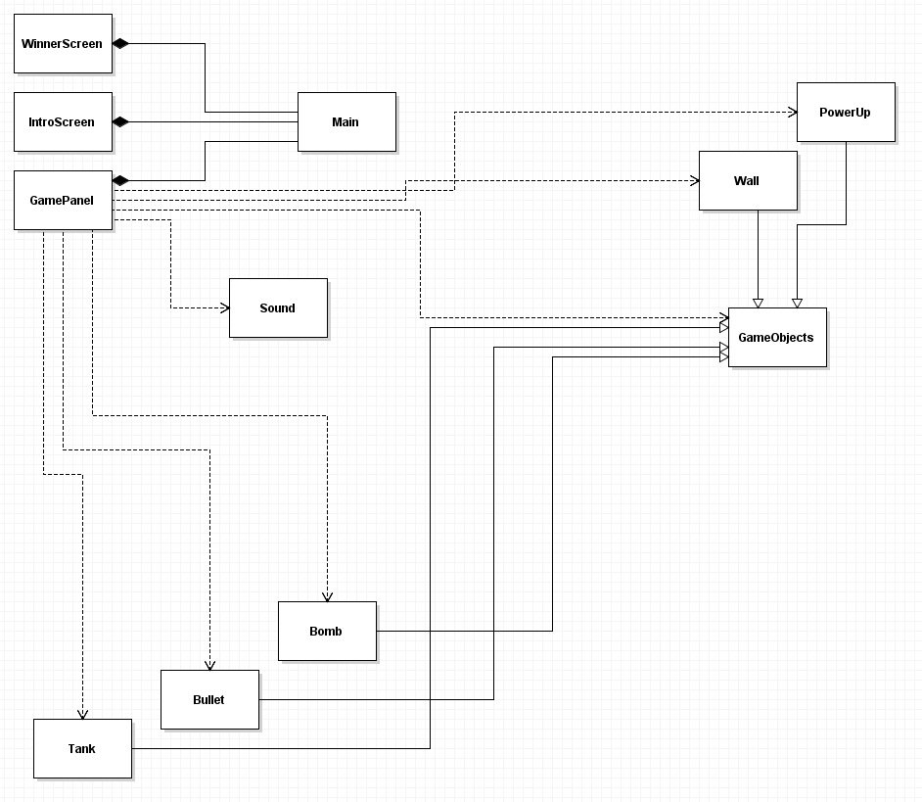
UML
Notes:
Raghava

Slide 9
Significant Design Decisions
Two main parts of our game
- Graphical User Interface
- Game components and logic
Divided up the game into packages
- GUI package: Holds all the panels and the Main
- Component package: Holds all the game objects
Decided to split up Bomb and the Health-Powerup because a bomb is not exactly a powerup
Combine all the levelPanels into one single panel
Notes:
Raghava

Slide 10
Hardest problems
Collisions
- Tank collision with other tank or wall (hard to find bug)
- Pop-up instruction screen within JFrame (Used JOptionPane)
- Shoot from a side-mounted turret
- Fixed by using a rotation matrix
Panels
- When I created three levels, all the actions done in one level were still occurring in the other levels, so when the players progressed to the next level, everything was misplaced.
- Fixed by: creating reset() method for relocating all objects and using a flag to determine if a current level is finished.
Notes:
Raghava and Aayush

Slide 11
Features, Bugs
Features
Multiple levels
Health bar
Power ups
Background music/ realistic tank warfare sounds
Bugs
Hitbox slightly off depending on direction of the tank
Sometimes may seem like bullet goes through tank
Notes:
Aayush Features and Raghava Bugs

Slide 12
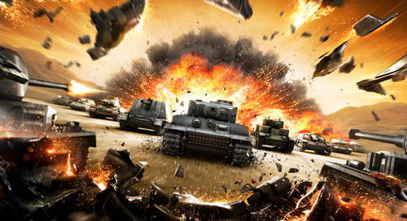
Let’s Roll out!!

Slide 13
Next Steps
2 or 4 player networking
Team battles
Player chat
Larger map created randomly
More tanks with unique attributes
Better graphics
Explosion effects
More unique power-ups, such as ability to go invisible
More user customization
Tank color, username, special ability of tank
Notes:
Aayush (first three) and Raghava (last four)

Slide 14
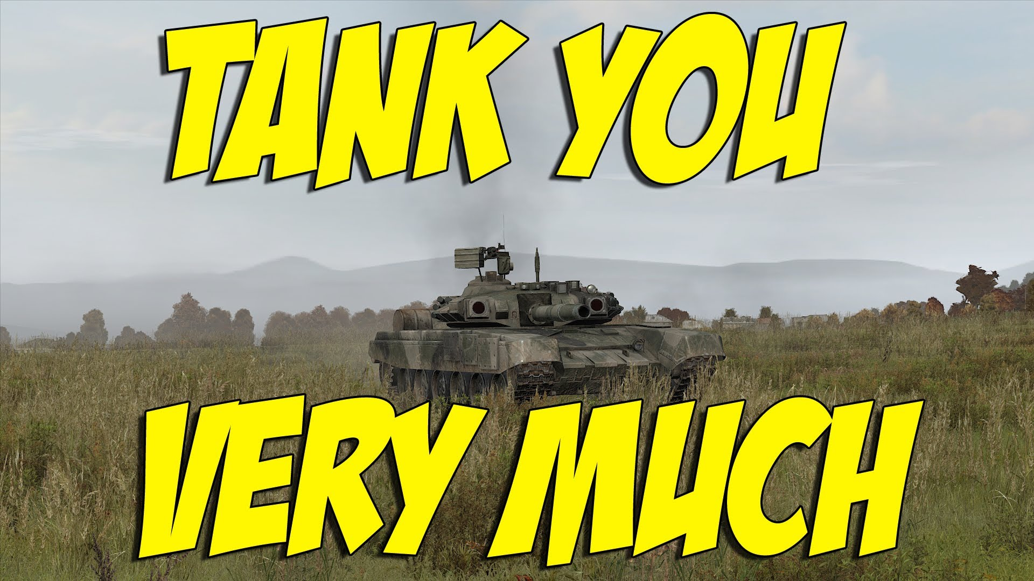
Thank You!

